Slide 1
Hospital flow insight

Slide 2

Capacity Focus with 90% (p90) Length of Stay ​(los)
Pinpointing long-stay conditions and the bed days we can free each week.

Slide 3
Project Overview
Analyzed hospital admission data to uncover patterns in patient flow, length of stay, and bed utilization to improve operational efficiency and resource allocation.

Slide 4
Dataset
-Source: Open Healthcare Dataset from Kaggle
-Size: 50,000 original rows, 15 columns
-Time Period: 6 Months of admissions
Key Fields: Admission Type, Condition, Length of stay.

Slide 5
Business questions
1. Which medical condition accounts for the most total bed days in the selected period?
2. Inside the chosen condition, which admission type has the longest median and p90 length of stay?
3. For that condition, which age group contributes the largest share of total bed days?
4. On which admit day do admissions and new bed days start the highest?
5. If we reduce the p90 LOS by 15 percent for the target condition, how many bed days per week will we free?

Slide 6

impact​
Potential to save 50+ Bed days monthly with targeted reductions.
Better Planning for admissions improves patient flow.
Support data driven decision making for hospital management.
Support Staff Scheduling.

Slide 7
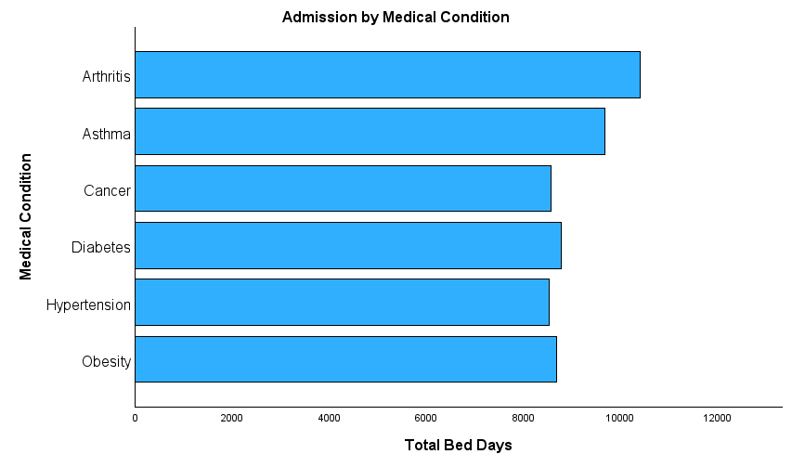
Question 1​
Which medical condition accounts for the most total bed days in the selected period?
Plain: Which condition kept our beds occupied the most in the first half of 2024?
Arthritis with a total of 10,406 bed days across 625 admissions, making it the highest of any condition in the time period. With this, Arthritis is the best candidate condition to target for freeing up beds.

Slide 8
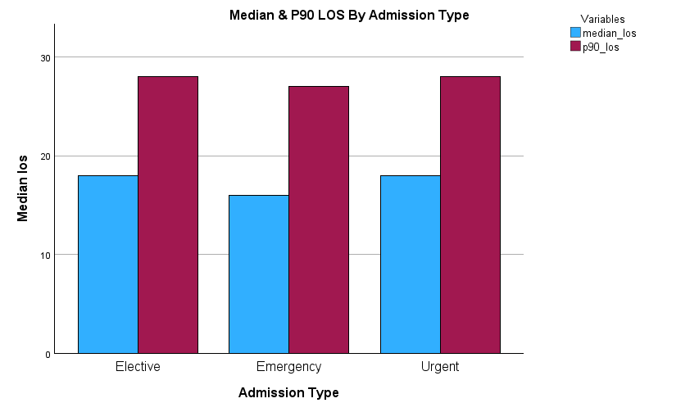
Question 2​
Inside the chosen condition, which admission type has the longest median and p90 length of stay?
Plain: For this condition, which admission type keeps patients the longest?
Elective and Urgent are tied for the longest stays with a median at 18 days and a p90 of 28 days, 200 and 197 admissions, respectively. Emergency has the most volume (228 admissions) with slightly shorter stays (median 16, p90 27).
Because our goal is to free the most bed days, we pick Emergency: its higher admissions volume x tail length delivers the largest bed days/week for any given p90 reduction.

Slide 9
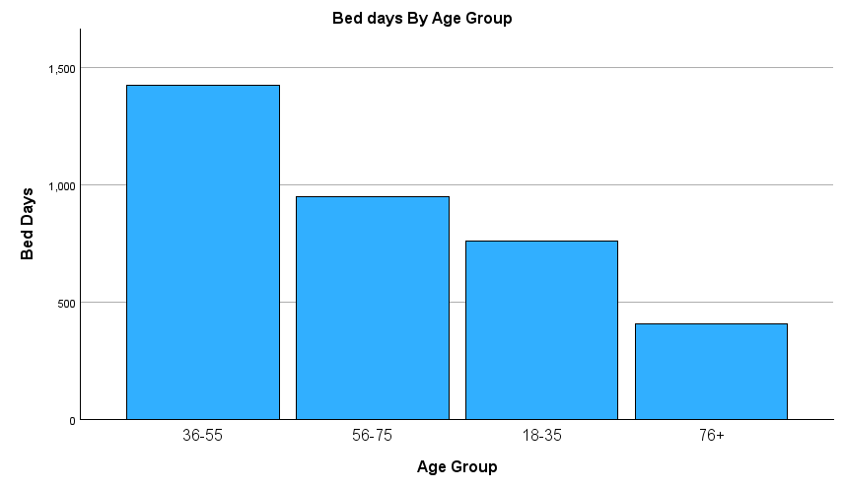
Question 3​
For that condition, which age group contributes the largest share of total bed days?
Plain: Within the chosen condition (in this case, Emergency), find the age group that contributes the largest share of total bed days.
36-55 Age Group Tops with a total number of 1425 bed days, 83 admissions taking up 40.2 percent of bed days.

Slide 10
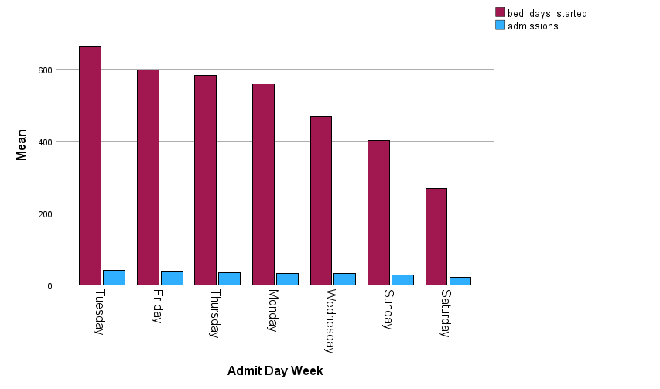
Question 4​
On which admit day week do admissions and new bed days start the highest?
Plain: Which day of the week do we admit the most patients and start the most bed days?
Tuesday leads with 41 admissions, 663 bed days, and contributes to 18% of admissions and 18.7% of bed days.
So-What: Anticipate Tuesday demand; add intake/discharge capacity and reserve Wednesday–Thursday diagnostics/step-down slots to protect beds.

Slide 11
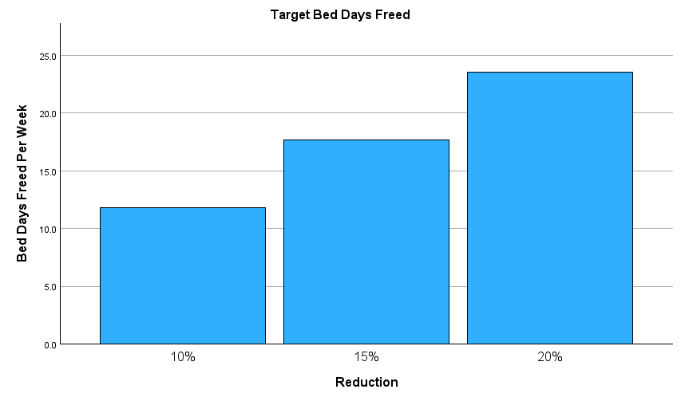
Question 5​
If we reduce the p90 LOS by 15 percent for the target condition, how many bed days per week will we free?
Plain: How many bed days per week can we free if p90 drops by 15%?
Cutting Emergency p90 by 10/15/20% frees about 12/18/24 bed-days per week, that’s roughly 1.7 / 2.6 / 3.4 beds back on the floor.

Slide 12
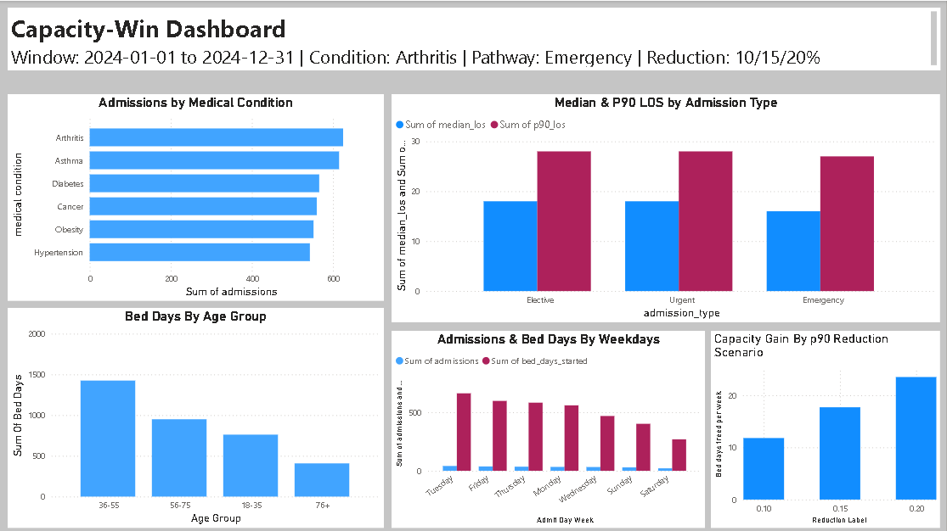
Dashboard snapshot

Slide 13
Conclusion
This analysis turns a messy admissions dataset into a clear, action-oriented plan to free bed capacity without adding staff or beds. By ranking conditions on total bed days, then looking inside the top condition at median and p90 length of stay, we identified where long stay “tails” are costing the most capacity and how much we can get back with modest process changes.
What matters most
Focus area: Emergency pathway within the target condition (Arthritis). Even though Elective/Urgent show similar p90s, Emergency’s higher admission volume converts small p90 cuts into largest weekly capacity win.
Sizing the prize: A p90 cut of 10/15/20% frees roughly 12/18/24 bed days per week. A pragmatic starting point is 15%, which is meaningful operationally but still achievable.
Who & When to design around: The 36-55 age group drives the largest share of bed days within Emergency for this condition, and Tuesday is the peak day for admissions and bed days started. That tells us where to standardize and when to staff diagnostics to shorten stays.

Slide 14
Recommendations & next steps
Standardize early steps for Emergency admissions in Arthritis
Protect mid-week flow (Tue-Thu):
Pre-book core tests and consults for likely next-day discharges; align transport and pharmacy cutoffs.
Measure visibly, weekly:
Track p90 LOS, admissions/week, and bed days freed/week. Require N>20 per group to avoid noise.
Lock in the win, then scale:
If the pilot delivers 18 bed days/week, standardize the playbook, and then extend it to the next high-impact condition/pathway.

Slide 15
Limitations and future upgrades
Data gaps: Diagnosis detail is limited to medical condition; severity, discharge destination, and case mix are not modeled.
Improvements: Add severity/comorbidity flags, discharge disposition, and time of day stamps; connect to live ED/ward rosters to test staffing alignment; automate the dashboard refresh and a what-if slider for a 10/15/20% reduction.
Bottom Line:
By trimming the long-stay tail in the Emergency pathway for the top bed day condition (Arthritis), the hospital can reclaim 2 to 3 staffed beds’ worth of capacity every week, a near-term win that reduces crowding and delays while protecting quality.

